Slide 1
Dignittack
Assisted Dying by Shark
Co-Founders: Flora, Jill, Johannes, Nimrod

Slide 2
Project Overview
Examine Shark Attack dataset
Come up with Business Case
Define hypotheses
Clean, transform, explore, analyze the data
MVP
Shark Attacks

Slide 3
Framing the product
Problem statement:
Euthansia is, to this day, widely illegal and socially unaccepted.
Hypothesis:
Geographical location and time of year are strong predictors of shark attacks.
Notes:
You may have heard of recent news (rather, debates and vitriol), around the subject of the right-to-life. But we are not here to talk about that. We’re here to talk about the right to die, specifically on one’s own terms. Specifically by shark.
But before we get to that, some context: the right to voluntarily end one’s life through medical assistance, also known as euthanasia, has been a highly contested subject since the mid-1800s. Indeed, the debate itself was nearly euthanized by a number of institutional opponents in the 1900s, who claimed that legalizing euthanasia would put society on a slippery slope and lead to unacceptable consequences. On the other hand, proponents state, among other arguments, that that people have a right to self-determination, and thus should be allowed to choose their own fate.
The debate still rages on, with little progress made in favor of ‚active‘ euthanasia (that is, the intentional hastening of death and not just the removal of life support services). There are a handful of places in the world that allow it, for example Belgium, Canada, and Colombia. However, despite its legality, there are still sometimes criteria that the patient must meet in order to be considered as a candidate for Euthanasia, and this can certainly remove some of the dignity that is often the keystone of this decision among patients.
This was our problem statement. Our hypothesis, that geographical location and time of year are strong predictors of shark attack, helped guide us towards out end-of-life solution, which removes the need for myriad medical and mental health checks, and maintains the dignity that patients seek, and even adds a bit of adventure for people who want to go out with a bang (or for people like me, who prefer to abstain from scary adventures until our sunset years, when the fear of dying will be much less of an inhibitor). That is: death by shark. From this we plan to develop an app, using real historical shark attack data, that lets our users see where they can pass by, to pass on.
I will now pass the mic to Johannes who will describe how we treated the data.

Slide 4
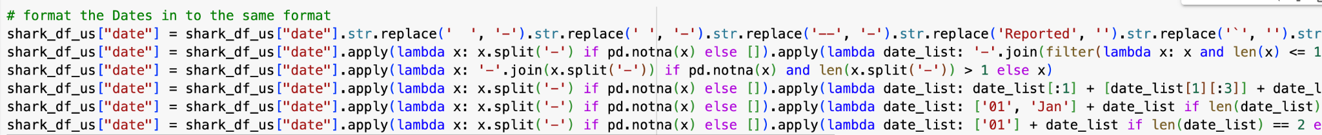
Cleaning and Transforming the data
Clean:
First and foremost: dropna
Columns: Empty columns after Species
Rows: subset = Country, State, Location
Fillna
Transform:
Transform state names, activity names, dates
if/else functions to create new categories: activity, shark species
Create function file
Johannes had a lot of fun

Slide 5
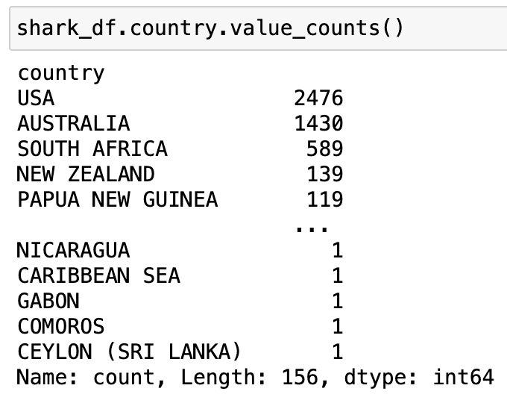
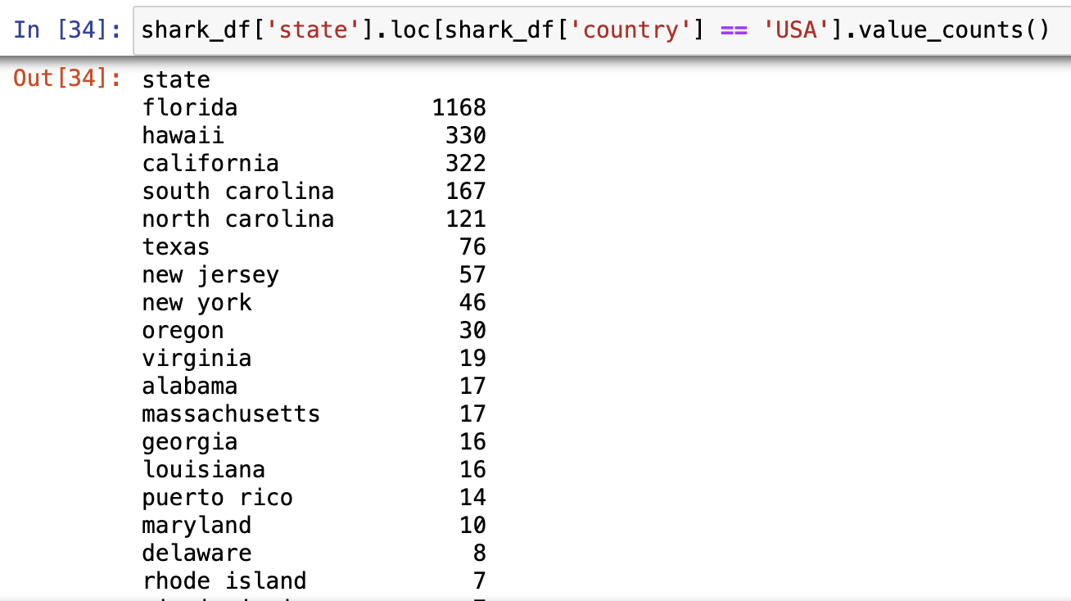
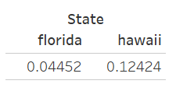
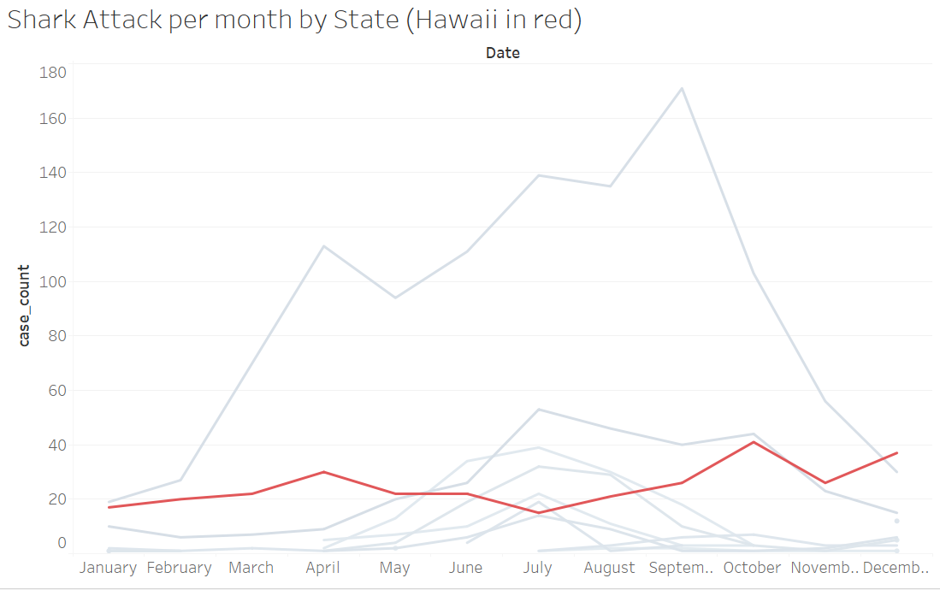
Exploring and Analyzing the data
Explore:
Top countries with shark attacks
Explore shark attacks by state in USA
Analyze:
Amount of shark attacks by time of year and location
Amount of shark attacks by activity
Florida vs. Hawaii: Injury vs. fatality
Fatality rate
Notes:
Looking more granularly at the data, we saw that different US states had different shark attack rates. Unsurprisingly, those closest to the water showed a strong correlation with shark attacks. At the top of the list was Florida - at first we thought, maybe we can build our MVP here, since it seems that this is the place with the greatest shark activity; however, as we know, correlation does not imply causation - we also considered that there are a lot of stupid people living in Florida, which could be skewing our interpretations. In fact, the ‚Florida Man Theory‘ is somewhat corroborated by the fact that though Florida has the highest number of shark attacks, the fatality rate is only 4% compared to 12% in Hawaii, which had the second highest incident rate in our US dataset. Moreover, the interest in Hawaii was strengthened by the fact that this state boasted the most consistent number of shark attacks all year round. This means our clients don’t have to wait until a certain season to close the chapter on the autumn of their life. Plus…it’s Hawaii, and you don’t need really any data to conclude that it’s a much nicer place than Florida.

Slide 6
Obstacles
Cleaning:
Time constraints: what do we care to clean? Which columns to prioritize?
Transforming:
How do we transform a column where values vary so vastly? E.g. Date
Time spent : (
Functions in a .py file in colab 👎
Analyzing:
export/import .csv file
Time: clean locations for beach-specific data
Notes:
So, this is where we’ll start. And as we develop further, we will focus on localizing suggestions for clients who live outside of, or are unable to travel to, Hawaii. Phase two will involve one of the bigger markets for euthanasia, and for sharks: that is, Australia. Of course this depends on the satisfaction of our customers in Hawaii, which may require a bit of speculation. However we feel confident that we will be able to find a product/market fit and are looking forward to serving both clients and sharks as we develop this idea.

Slide 7
Conclusion
This is just the beginning!..for us, not our clients.
Notes:
So, this is where we’ll start. And as we develop further, we will focus on localizing suggestions for clients who live outside of, or are unable to travel to, Hawaii. Phase two will involve one of the bigger markets for euthanasia, and for sharks: that is, Australia. Of course this depends on the satisfaction of our customers in Hawaii, which may require a bit of speculation. However we feel confident that we will be able to find a product/market fit and are looking forward to serving both clients and sharks as we develop this idea.

Slide 8
Thank you!
Flora, Jill, Johannes, Nimrod

Slide 9
